Slide 1

CREATIVE
CHALLENGE
GROUP 21

Slide 2
JUNBYUNG PARK
DOYUN GU
WOOSUNG JUNG
DOHYEONG KIM
GROUP 21

Slide 3

THE PROBLEM.
“I WANT TO KNOW HOW MANY STUDENTS ARE UNDERSTANDING MY LECTURE”
Hard to track student engagement in real time.
No quick feedback on who is confused or participating.

Slide 4
SMART CLASSROOM ENGAGEMENT TRACKER
SMART CLASSROOM ENGAGEMENT TRACKER

Slide 5
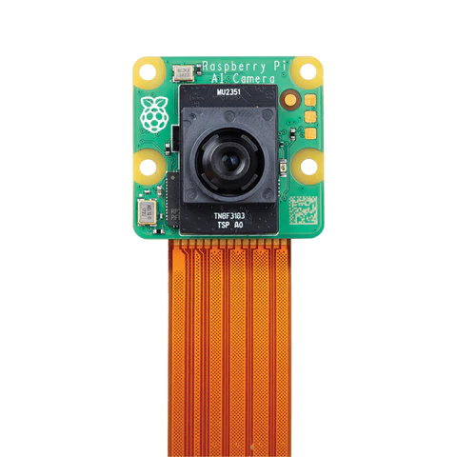
OUR SOLUTION.
AI-POWERED CAMERA WITH POSENET DETECTS EVERYTHING!
Who is present
Who raises their hand
Who seems to understand
AI-POWERED CAMERA WITH POSENET DETECTS EVERYTHING!

Slide 6

HOW IT WORKS.
LOGIC DETECTS RAISED HANDS VS. PASSIVE STUDENTS.
Who seems to understand
FRAME DETECTION COUNTS NUMBER OF STUDENTS
How many students showed up
Percentage of people raising hands

Slide 7
LIVE DEMO

